Slide 1
Detecting brain tumors in MRI Scans
using Deep Learning
Rosa Kim Cho
CPSC 589

Slide 2
Introduction
Majored in Cognitive Science at UCSD with a background in neuroscience and human-computer interaction (UX design)
Did research for an Autism Spectrum lab by recording and measuring brainwave activity using electrodes and EEG
Worked as a freelance UX Designer and science/tech writer

Slide 3
Overview
How do we turn a series of electrical pulses into an image and then turn the series it’s a part of into usable data?
MRI Scans
Neural Network
Analytical Results Data visualization

Slide 4
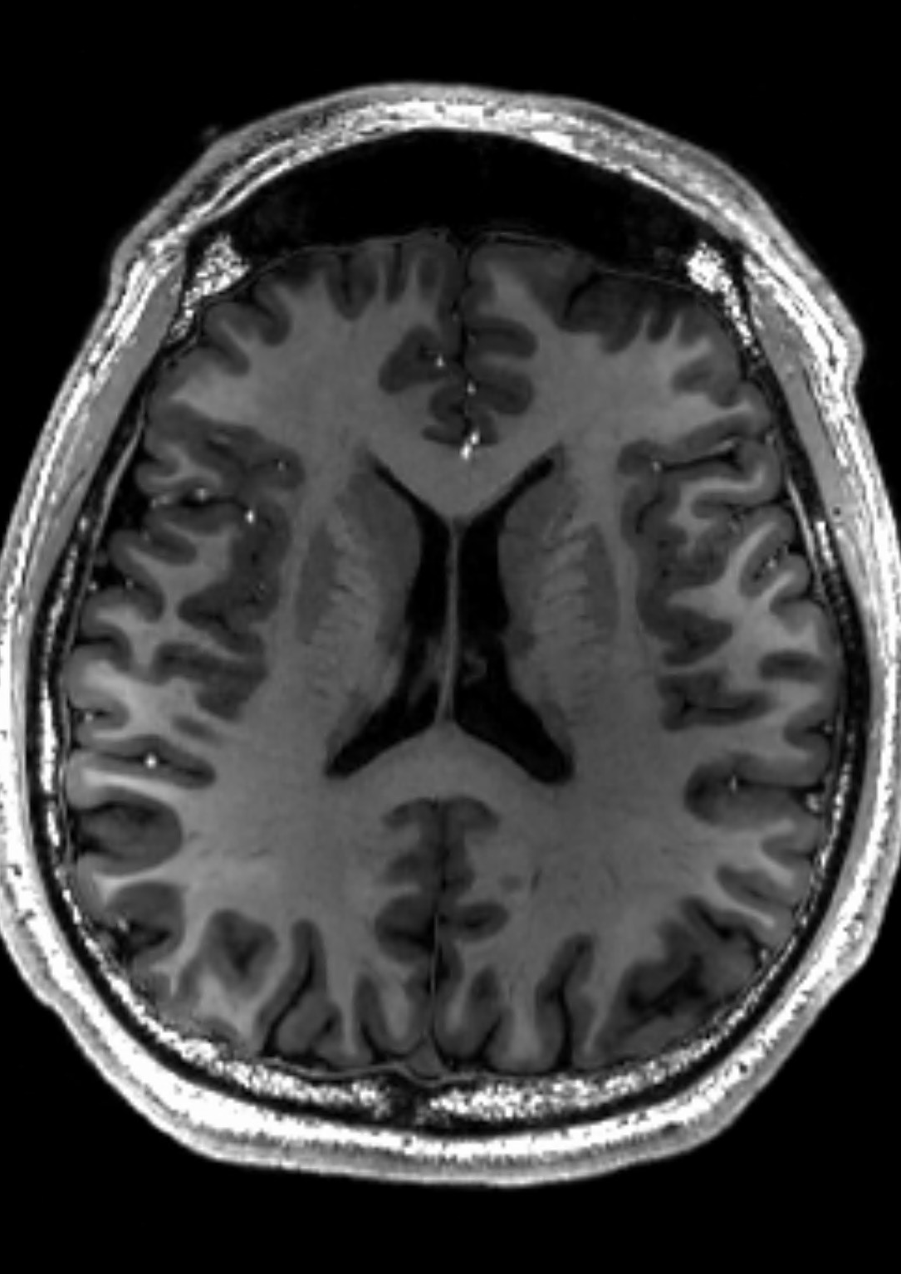
MRI (Magnetic Resonance Imaging)
MRI (Magnetic Resonance Imaging) works by using magnets to create pulses that stimulate the protons within a person’s body
This generates a resonance field that is detectable through sensors
The sensors translate the signals into image data
MRIs are preferred for neural imagery because of its non-invasiveness nor use of radiation which would damage brain tissue

Slide 5
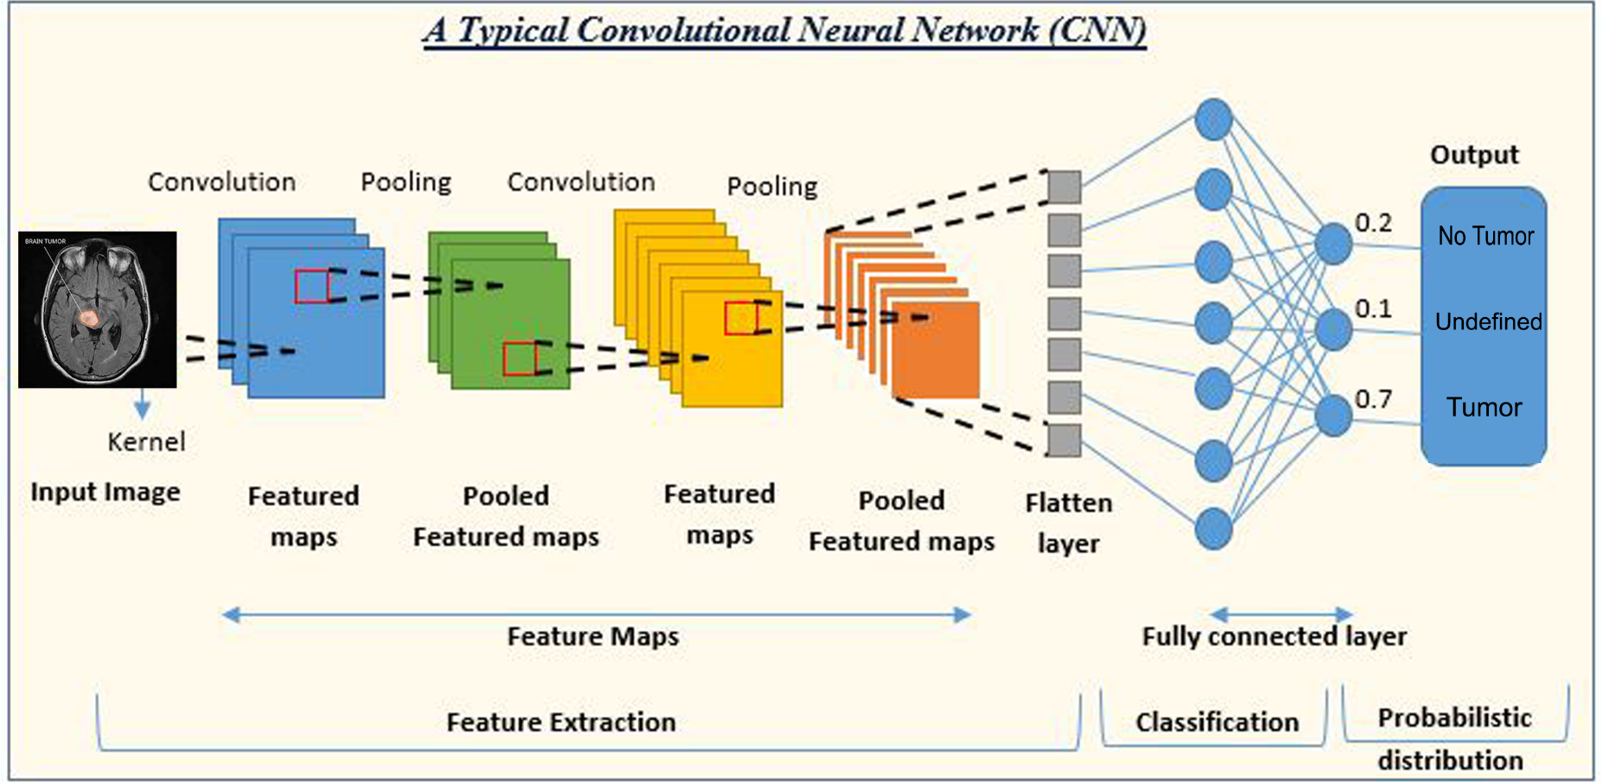
CNN (Convoluted Neural Networks)
LAYERS
1. Image Input
2. Feature Extraction
a. Feature Maps
b. Max Pooling Layers
c. Batch Normalization
3. Classification
a. Density Layers
4. Probabilistic Distribution
a. Tumor
b. No Tumor
c. Undefined

Slide 6
Challenges
Preprocessing +1000 MRI scans
Creating a unique CNN-based machine
Determining levels of accuracy based off of types of tumors, location of tumors, or simply whether or not there are tumors present

Slide 7
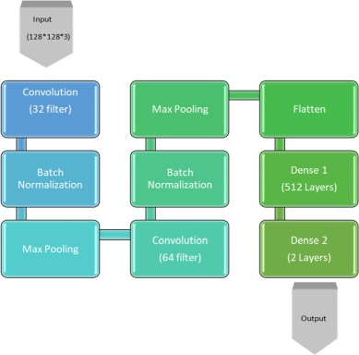
9-Layer CNN Map utilizing Segmentation
A 9 layer model based off of segmentation methods
Segmentation: a clustering method used to group pixels based off of similarity
2/9 = Feature Extraction
3/9 = Classification Filters are applied to determine anomalistic details
Accuracy rate = 99.74% based on 2473 training images, 273 testing images

Slide 8
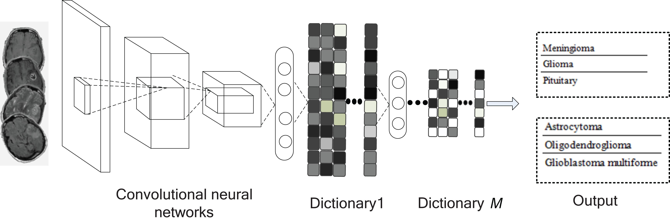
MRI Classification Using Convolutionary Dictionary Learning
Dictionary learning: an unsupervised learning framework that takes in a matrix, factorizes it using the training data, and returns a sparse representation of that applied data to the matrix
In this case, applying the mathematical principles of Dictionary Learning to the CNN should return different classifiers representing different types of tumors
3 Classifiers: AST (astrocystoma) , OLI (oligodendroglioma), GBM (glioblastoma)
Accuracy Rate: between 88% - 94% depending on classifier, location of each tumor

Slide 9
Discussion Questions
Dictionary-learning approach, 9-layer, or a combination of the two?
Would a tumor classification library be necessary if the final goal is just tumor detection?
Any opinions regarding the biomedical imaging field in general?

Slide 10
Thank you !

